Slide 1

Business plan of Money lending business in Singapore
27.07.2015

Slide 2
Table of contents
1 | Investment summary
2 | Market overview
3 | Legal setup
4 | Product and Marketing
5 | Decision making & Collection
6 | Business process & IT
7 | HR & Admin information
8 | Finance
9 | Project risks and mitigation
10 | Project plan
11 | Next steps

Slide 3
Investment summary

Slide 4
Investment summary
The Singapore moneylending (ML) market is one of the most challenging ones we have seen so far due to a number of overlapping factors:
It is relatively small in terms of number of people, which is balanced out by high income per capita
It is very obsolete in terms of financial technologies utilized in ML market, which presents on one hand huge opportunity in case we are able to disrupt the market with new technologies, or, on the other, a big risk in case we are not allowed by the regulator to introduce such changes into the market
The role of regulator in the market is quite significant and, while our initiatives are fully in line with the regulator activities towards making the market more institutionalized, it is not clear at this point how long it will take for the regulator to accept new technological reality
We believe the market can be significantly transformed by the use of modern financial technologies, and in such case is positioned to achieve financial results as outstanding as those of ML businesses launched by our group in some of the more developed European economies
However, to achieve that we need to progressively work with the regulator on introducing new business processes to the market, moving closer and closer to the “ideal” online business model so suitable for otherwise modern Singaporean society:
Online client acquisition
Online contract signing
Cash-free loan disbursement

Slide 5
Investment summary
Investment summary |  |  |  | Timeline
thsd USD | Year 1 | Year 2 | Year 3 | Year 4 | Year 5* | Total
investments | 3 131 | 5 980 | 115 | 0 | 0 | 9 226
Total investments | 3 131 | 5 980 | 115 | 0 | 0 | 9 226
Number of loans issued (thsd) | 1 | 27 | 51 | 62 | 67 | 208
Amount disbursed | 1 684 | 37 647 | 70 956 | 86 158 | 93 142 | 289 586
Net portfolio (EoY) | 759 | 6 363 | 9 097 | 10 702 | 11 019 | 11 019
Revenue | 348 | 10 255 | 21 070 | 26 065 | 28 512 | 86 250
One-off expenses | -1 113 | 0 | 0 | 0 | 0 | -1 113
Net profit after taxes | -1 141 | 205 | 4 617 | 6 876 | 8 050 | 18 607
ROE (yearly) | -65% | 3% | 48% | 72% | 84% | 53%
ROAA (yearly) | -97% | 4% | 47% | 57% | 61% | 39%
* - normalized year with no new clients growth
Break-even period – 18 months
Payback period – 29 months
Maximum investments from shareholder – 9,2 mln USD

Slide 6
2. Market overview

Slide 7
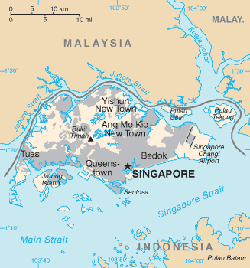
General market information
Population of Singapore – 5,5M (62% citizens, 11% permanent residents, 27% foreign nationals). Urban population is 100%.
Ethnic composition: 75% Chinese, 15% Malay, 10% Indian
Official languages: English, Mandarin Chinese, Malay and Tamil. English is the common language, and is the language of business, government, and the medium of instruction in schools
GDP per capita (nominal) is 9th in the World and stands at USD 56K per year, average monthly salary is USD 3,8K (2014)
The population is significantly indebted, with consumer loans per capita at USD 55K*, and consumer loans to GDP at 76%
Mobile phone penetration rate is extremely high at 156%, Internet penetration is high at 73%
Singapore reports the highest smartphone penetration in the world at 85% (up from 72% last year)
98% of the population have bank accounts, online banking penetration stands at 52%, credit card penetration is 37%
*Compare GDP with other Asian market – appendix 1

Slide 8
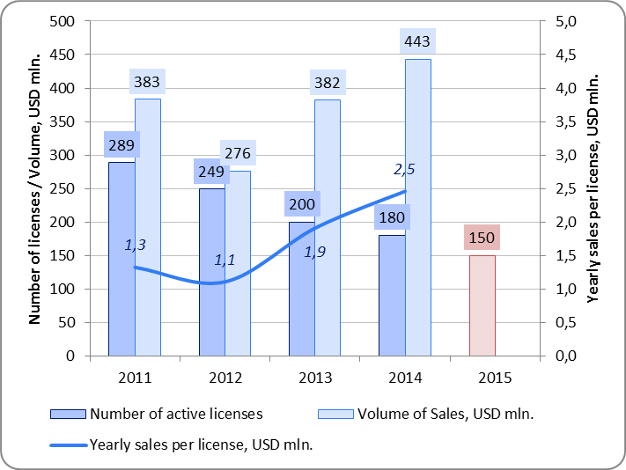
PDL Licensing
Consumer lending in Singapore is performed by Banks, Licensed Moneylenders and Pawnshops
PDL is a known product in the market falling under definition of “Moneylending” and licensed as such by Registry of Moneylenders, Ministry of Law
Regulator stopped issuing new licenses in 2012, and targets the total number of active licenses to be 150 by the end of 2015
This policy led to the gradual reduction in the number of active licenses in the past few years
Currently there are 176 ML licenses in the market (172 are active and 4 are already suspended)
Despite steady decrease in the number of licenses, lending volume kept increasing due to more sophisticated marketing (online), rising ticket sizes, decrease in illegal ML activities and rising client demand

Slide 9
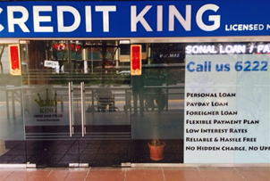
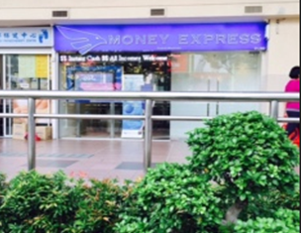
Current ML industry practices
The only business model detected in the market is branch-based
While the ML regulation formally allows for ML businesses to have multiple branches, only 5 MLs with 2 offices have been identified
There are signs of concentration in the industry, exhibiting themselves in a peculiar way in such regulated environment
This concentration happens not via expansion of a specific license, but rather by license operator taking under his control multiple licenses formally belonging to different individuals
During our limited investigation time, we have come across at least one person operating 19 licenses and another operating 5, there are reasons to believe that this phenomenon is widespread and the actual number of players is relatively small
Such mode of industry concentration has been dictated by harsh regulatory environment in which license operators diversify risks of license revocation by spreading business activities over multiple licenses
In such a scheme, licenses are operated via “trust” agreements in which owners are paid 11-15% of gross profit or 20-30% of net profit

Slide 10
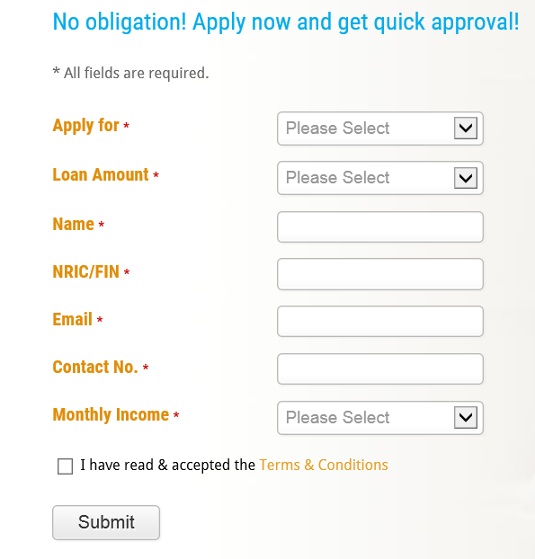
Current ML business processes
Majority of Moneylenders have their websites, which allow customers to fill out short applications
After short app is submitted, it is reviewed, and in the case of pre-approval, the client receives the phone call from ML inviting him to come to the branch with supporting documents
The loan is usually disbursed on premises as cash, or is transferred to the client’s bank account
All this allows to classify the existing model as O2O

Slide 11
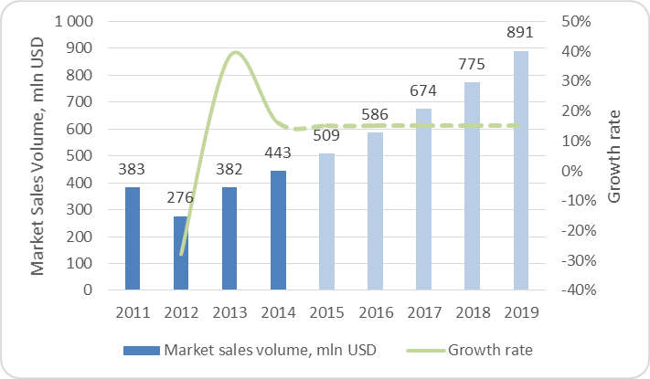
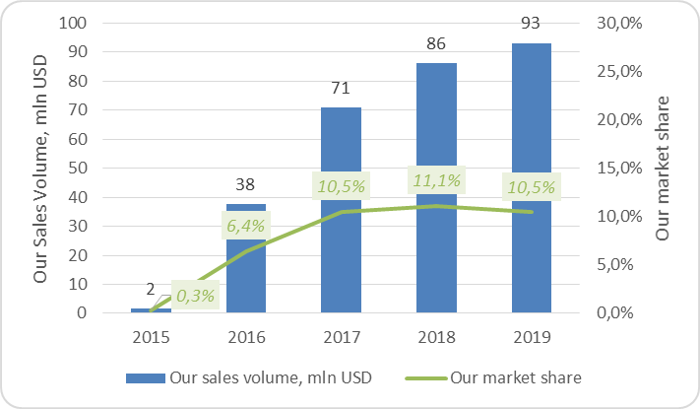
ML market sales volume and our market share
Market Sales Volume*
Our Market share & Sales Volume
Main assumptions:
Market growth – 15% for 2015-2019
Our market share from 2017: 10,5%
Upcoming restrictions of bank lending
Starting from 1 June 2015, The Monetary Authority of Singapore (MAS) limited the unsecured credit facilities per customer - max 24 times monthly income
As a result, according to the opinion of the President of the Moneylender's Association of Singapore, there will be a 20 to 30% rise in borrowing volume from licensed moneylenders
Our market share and sales volumes depend on our ability to generate client influx, which we are going to do with the help of marketing tools
* Total ML market, including all ML products (PDL, Installment loans)

Slide 12
3. Legal setup

Slide 13
ML regulation
Regulator:
Registry of Moneylenders (Ministry of Law)
Regulations documents:
MONEYLENDERS ACT 2008 (ACT 31 OF 2008)
MONEYLENDERS (PREVENTION OF MONEY LAUNDERING AND FINANCING OF TERRORISM) RULES 2009
MONEYLENDERS RULES 2009
DIRECTIONS OF THE REGISTRAR UNDER SECTION 16(3) READ WITH SECTION 26(1) OF THE MONEYLENDERS ACT REGARDING THE ADVERTISING & MARKETING ACTIVITIES OF LICENSED MONEYLENDERS
Regulation practice:
All licenses must be renewed on a yearly basis, following the inspection conducted by the Regulator
The industry has historically been “non-institutional”, with many ML businesses set up as sole proprietorships and operated by underworld figures
The Regulator approach to the business reflects its historical positioning, with many Regulator employees having previous experience at the Police Department
During toughening licensing campaign, the usual reasons for license revocation are:
exceedingly tough or borderline collection practices
failing to comply with clear information disclosure about effective APR to the customers
failing to provide adequate client information to the Regulator

Slide 14
Regulator restrictions and market opportunities
Restrictions | Opportunities
New license issuance restriction: Ministry of Law impose moratorium on the issuance of new licences in 2012 | We will enter the market through acquisition of an existing license
Moneylenders are allowed to advertise its services only using the following channels: Business or consumer directories in print or online media internet websites belonging to the licensee Moneylender’s office | We will launch or work on a commercial basis with a lead generating company (LGC) which operates as a business directory or loan comparison site to create application inflow. This approach is already used by existing players.
KYC requirements: Conducting face-to-face identification of potential customers or their agents is mandatory | We are investigating ways of customer identification alternative to face-to-face: Relying on client identification done by the bank at the account opening stage By third party – e.g. couriers of LGC
Pricing regulation: Interest cap Commissions cap | We will charge fees through LGC
We are working with the local legal firms to build a case for implementing new rules of the game in the market

Slide 15
Regulatory environment
Case study – Money3 PTE LTD - http://www.money3.com.au
Top 50 in Singapore rate Australian moneylending company with branches in Australia (more than 400 000 customers), Singapore and Ireland, uses modern technologies and disburses online loans in Australia.
Features of operations in Singapore:
Online “long” application form filling
Online credit report requests from Credit Bureau of Singapore
Loan disbursement to bank accounts (most moneylenders - in cash)
IOS application for IPhone and Ipad
A customer friendly documents check with only basic documents required
Money3 was one of the most progressive moneylenders in Singapore and operated there for more then 5 years. However, in April 2015 their license was not renewed by the regulator. The formal reasons were:
recklessly furnishing false information to the Registrar
failing to supply a statement of accounts to a borrower
contravening a condition of license by employing a staff without the Registrar’s prior approval
Money3’s case suggests extreme caution in dealing with the Registrar. However, once formalities are observed, and regular dialog with the Registrar is established, it should be possible to introduce new techniques into the market

Slide 16
Results of approaching market players with offer to sell
Existing business with assets
Company name | Proposed deal | Pros | Cons
AP Credit | $ 6.58 mln Ready to sell 100% shares | An established company with high revenues Large customer base (2,500) Pretty low NPL level (4,9% at 90 DPD) | High selling price Inconvenient branch location
Crawfort Pte Ltd | Price is unknown Ready to sell up to 75% shares | High growth rate income (2 times last year) | Inconvenient branch location
Fast Money PTE LTD | $ 7.88 mln Ready to sell 100% shares | 2 branches with convenient location High-ranked company website | High selling price
License option without assets
License name | Proposed deal | Pros | Cons
SE Automobile Investment | $ 284 thsd Ready to sell 100% shares | Lowest price | The owner is unreliable: constantly changes the deal terms and refuses to sign LOI
EASI ADVANCE PTE. LTD | Unknown | Company is currently not operational | high probability of license revocation by the Regulator
Best option for us is to buy into a pure license, as this can significantly reduce the purchase price

Slide 17
№1 AP Credit
Name of company | AP Credit
Web | http://www.apcredit.sg
Price | $6.58 mln
Net profit before taxes | $1.13 mln
Number of branches | 1
Average loan size | $3 550
The cost of raising 1 client | $40
Average number of loans per month | 170
Average interest rate | 25% per month
% of repeated customers (monthly) | approx.50%
Seller operates 19 licenses in Singapore
Company has high rate (top 30) website in search system
The target audience of the company's management are:
customers who work in the financial centre of Singapore and business owners, who needed fast loan
Seller leases office in Singapore business area

Slide 18
№2 Fast Money Pte Ltd
Name of company | Fast Money Pte Ltd
Web | http://www.fastmoney.com.sg
Price | $7.88 mln
Net profit before taxes | $1.91 mln
Number of branches | 2
Average loan size | $700
The cost of raising 1 client | $35
Average number of loans per month | 300
Average interest rate | 28% per month
% of repeated customers (monthly) | approx.40%
Seller operates several licenses in Singapore
Fast Money is one of 5 companies in Singapore with 2 branches
Company has high rate (top 30) website in search system and often meets on online business directories
The target audience of the company's management are:
Customers whom are unable to obtain loan from local banks
Customers who lives or work near offices and needed fast loan
Seller leases offices in low level residential areas

Slide 19
№3 Crawfort Pte Ltd
Name of company | Crawfort Pte Ltd
Web | www.crawfort.com.sg
Price | Not available
Net profit before taxes | $1.35 mln
Number of branches | 1
Average loan size | $1750
The cost of raising 1 client | Not available
Average number of loans per month | 280
Average interest rate | 25% per month
% of repeated customers (monthly) | approx.50%
Seller operates one license and wants to find strategic investor
Seller has low rate (top 100) website in search system, bur very often meets in online business directories
The target audience of the company's management are:
Customers who are unable to obtain loan from local banks and customers
Customers who live or work near office and need fast loan
Seller leases office in a dormitory district of Singapore
Clients flow near the office is extremely low

Slide 20
№4 SE Automobile Investments
Name of company | SE Automobile Investments
Web | http://www.sgloan.sg
Price | $284 thsd
Net profit before taxes | Not available
Number of branches | 1
Average loan size | Not available
The cost of raising 1 client | Not available
Average number loan per month | Not available
Average interest rate | 25% per month
% of repeat customers (monthly) | Not available
Seller operates several licenses in Singapore and wants to sell the license
Seller leases office in sleeping quarters of Singapore

Slide 21
Optimal target
SE Automobile Investment is the main target license under consideration
Shareholder is ready to sell
Price of license is the cheapest compared to al other offers – $284 000
Sale process:
As a first step, the current owner must transfer company from Sole Proprietorship to Private Limited, which is necessary for transfer of shares of the company
Next step – the owner must submit documents to Regulator for approval of sale of 100% or less of the shares. Regulator’s approval is the guarantee that license is legal and we can start our moneylending business
Easi Advance Pte Ltd
2nd option to buy license
Shareholders have only license without business
There is a risk of not extending the license by Regulator: Regulator could stop the license in case of the lack of operations
1 of 2 shareholders wants to sell the license
We are in negotiation process

Slide 22
4. Product and Marketing

Slide 23
Competitor landscape
Type | Interest rate | Loan amount | Tenor | Documents | Time-to-Money | Contract signing
Licensed Moneylender | 300%-720% annualized | $185 – $37 000 | From 1 week up to 12 months | ID, Salary proof, Home address proof | 30 minutes – 2 hours | In office
Unofficial lender | up to 1018% annualized | $740 – $14 800 | From 1 week up to 12 months | ID, Salary proof, Home address proof | 30 minutes – 2 hours | No contract signing, relationship is fully unofficial
Pawnshop | 12-30% annualized | $250 – $37 000 | From 1 week up to 6 months | ID + Collateral | immediate | In office
Bank | 6-28% annualized | Up to $88 800 | 12-60 months | ID, Salary proof | 5-10 working days | In branch
Licensed moneylenders are our direct competitors. However, we expect part of the supply currently provided by the banks, to be replaced by supply from Moneylenders (due to upcoming regulation)

Slide 24
Сurrent standard sales process of ML
1. Online application and preapproval
2. Branch visit
3. Decision making
The client applies online through the company website
The application includes client consent for all the checks (credit bureaus, black lists, other moneylenders databases etc.)
The company performs all the necessary checks and makes a credit decision
If the decision is positive, the manager of the company calls the client and invites him to visit the company’s office
The clients come to office with min package documents:
Passport/ID/NRIC/FIN
1-3-6-12 latest original pay slips or Employment agreement
Most when customer takes more then 3000:
Proof of residence (a rent agreement or paid utility bills)
Paid invoice for the phone
Bank account statement
Work permit (for foreign workers)
Depending on the loan sum and product offered, the list of required documents might be shorter or longer
Checking black list in online interface
Checking Credit bureau in online interface
Taking hard copy all documents
Loan officer makes decision if loan is less then S$3000. If loan is more then S$3000, a manager makes decision
Entering information about the client in accounting program
4. Contract information
5. Documents signing
6. Money disbursement
The manager of the company informs the client of all significant details of the contract, including:
the effective interest rate for the loan expressed as a percentage per annum
the effective interest rate for the interest (if any) to be charged on late payment of the principal and interest
whether any permitted fees will be charged, how they will be computed and the circumstances under which they will be charged
repayment schedule
The client signs the documents:
Loan Application
Borrower’s consent for release of information
Authorization Letter
Payment schedule (Form 1)
Contract
Payment Voucher
Acknowledgement Page
Terms and Conditions
GIRO authorization (if the contract gives the lender the right to withdraw money from the customers account)
Most of the moneylenders disburse loans in cash at the office
Only several advanced companies transfer loan amount on customer’s account
Process – off-line
Time To Money – 0,5-2 hours after providing all necessary documents at ML's branch

Slide 25
Upcoming regulation of ML
Advisory Committee announced 15 recommendations to strengthen moneylending regulation*:
12 of the 15 recommendations were accepted by Government
2 recommendations – to lift the moratorium on the granting of new licenses and to regulate debt collection behavior – will be reviewed in time, as the industry adapts to the new regulatory changes
1 recommendation - advertising restriction cancelation – was not accepted by Registry of Moneylenders
New regulation in comparison with existing rules:
# | Fee name | Current rules | New rules (to be implemented in 2015)
1 | Administrative upfront fee | Not allowed | Up to 10% of the loan amount
2 | Interest cap for: low incomes customers (<S$30K per year) High incomes customers (>S$30K per year) | 20% per annum No cap | 4% per month
3 | Overdue interest/Late payment fee | Allowed, no cap | 4% per month (additionally)
4 | Late payment flat fee | Not allowed | max.44 usd per month
5 | Loan tenor | Not regulated | Repayments should be aligned to a borrower’s wage cycle, and should be set on a monthly basis by default.
6 | Fee for changing loan terms upon customer’s request | Allowed, no cap | Not allowed
7 | Fee for each case of dishonored cheque issued by customer | Allowed, no cap | Not allowed
8 | Fee for each unsuccessful GIRO deduction from a bank account (as payment to the moneylender) | Allowed, no cap | Not allowed
9 | Fee for early redemption of the loan or early termination of the contract | Allowed, no cap | Not allowed
10 | Legal costs incurred for the recovery of the loan | Allowed, no cap | Not allowed
11 | Any other fees and commissions | Not allowed | Not allowed
* We trace the changes on the official website of the Ministry of Law https://www.mlaw.gov.sg
** Full list of recommendations see in Appendix 2

Slide 26
Our product strategy
New regulatory restrictions are forcing MLs to compile very similar products:
# | Parameter | Existing ML product | Expected competitor’s product* | Our product proposition
1 | Loan amount range | $185 – $7400 | $250 – $8000 | $500 – $3700
2 | Avg Loan amount | $1106 | $1250 | $1250
3 | Loan tenor range | 1 week - 3 month | 1 month (fixed) | 1 month (fixed)
4 | Avg Loan tenor | 1 month | 1 month | 1 month
5 | Upfront admin fees | No | Up to 10% (capped at 10%) | 9.9%
6 | Interest rate | 15% -35% monthly (up to 60% in some cases) | 4% monthly (capped at 4%) | 3.9% monthly
7 | Late interest rate | 1% per day | 4% monthly (capped at 4%) | 4% monthly
8 | Late fee | No | Up to $44/month (SGD 60) | $44/month (SGD 60)
9 | LGC fee | No | No | 4.9% for each contract
We plan to be on par with the market in terms of pricing, and simultaneously focus customer attention on other advantages of our offer: short list of the documents needed, online credit decision, convenient contract signing process, loan disbursement to customer’s existing bank account
* In the line with upcoming regulation, based on insider market players information
** subject for legal approval

Slide 27
Our Effective interest rate calculation
Effective interest rate components (per month, based on average loan duration of 58 days*)
 | Component | Value | Comment
1 | Upfront admin fees | 5.2% | Collected for each loan disbursed
2 | Interest rate | 3.2% | Includes only payments made on time
3 | Prolongation fees | 1.6% | Collected for each prolongated loan
4 | Flat late fees | 0.9% | $44 per each loan not paid on time
5 | Late payment interest rate | 1.7% | Double interest rate paid by non-defaulting delinquents
6 | Credit losses | -2.9% | Defaulting loans
 | Total | 9.8%
To reach target EIR (13% monthly), we consider additional ways to increase Effective interest rate:
№ | Method | Comment
1 | Split loan into 2 loans for increasing late fee contribution | Might be assumed as abuse of the right. We will make this if It becomes common market practice
2 | Small tricks - early cut-off time on payment day | Might be assumed abuse of the right. We will make this if It becomes common market practice
3 | LGC fee – fee form Lead generation company for compare and consult service | We will apply. See next slide
Our EIR rate will be 9.8% monthly at launch. We will closely monitor market practice and will pilot additional ways to increase Effective interest rate. Within two months after launch we plan to start earning additional income in the form of LGC fees – 4.9% for loan disbursement and 4.9% for loan prolongation, which will increase the EIR to 13,1%.
* Including prolongations and payments past due

Slide 28
LGC contribution to EIR
Since we are planning to use LGC for marketing purposes, me may just as well use it for earning additional income, charging additional fees on the ground of services provided for:
competitor offers comparison
client consultation for choosing best loan option
client initial eligibility checkign
sending client application form to ML
Fee size – 4.9% of disbursed loan amount. Will be taken only after loan disbursement from the customer
Feasibility:
While this is currently not a common market practice (because of absence of interest rate cap), market experts verbally confirmed its feasibility for the future
We are validating this option with our legal partner and regulator

Slide 29
Marketing regulation in details
Restrictions
ALLOWED: Money lenders’ own websites Money lenders’ own physical POS Organic search (SEO): money lending “key words” only
ANY OTHER ADVERTISING IS NOT ALLOWED: ATL (e.g.: TV, radio, outdoor) BTL (e.g.: promo, direct) Digital (e.g. banners) DM (e.g. mailings) ADDITIONAL PROHIBITIVE LEGISLATION introduced for some specific types of communications. They are explicitly forbidden, e.g: Paid search Organic search or any digital targeting “gambling” audience Printed directories have quotas to place money lenders ads Online directories outside dedicated ML sections Social media of any kind (Facebook, Youtube etc) Outside physical POS exterior surface Any sales in SMS and @mailings including customers
Legal ways of marketing are quite
limited due to restrictive legislation.
Marketing section information sources:
Open sources (industry articles and reports)
Legal sources (legal consultants, existing regulation)
Industry insiders:
Money lenders (existing)
Money lenders (who left the market)
Media suppliers (online directories and comparison sites)
Advertising agencies

Slide 30
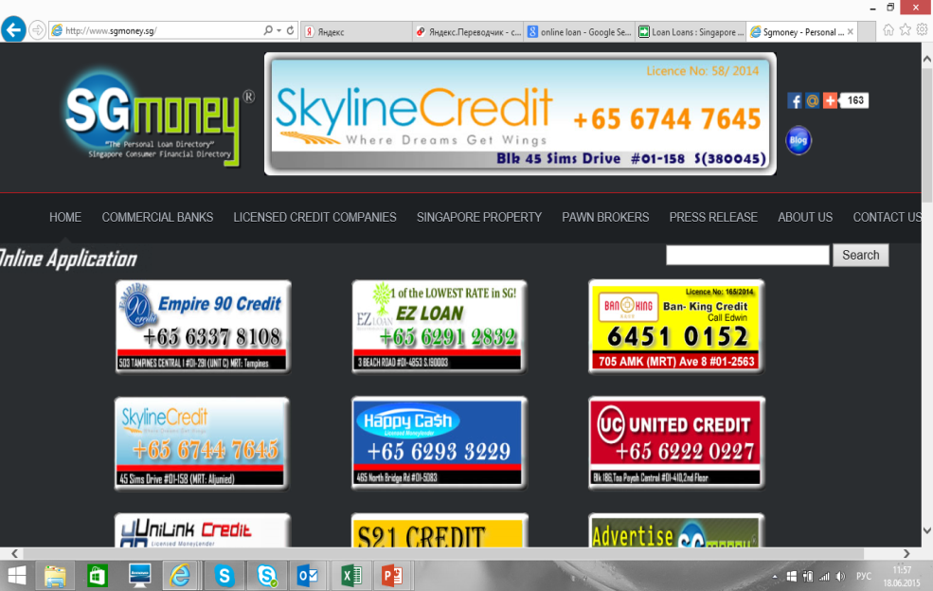
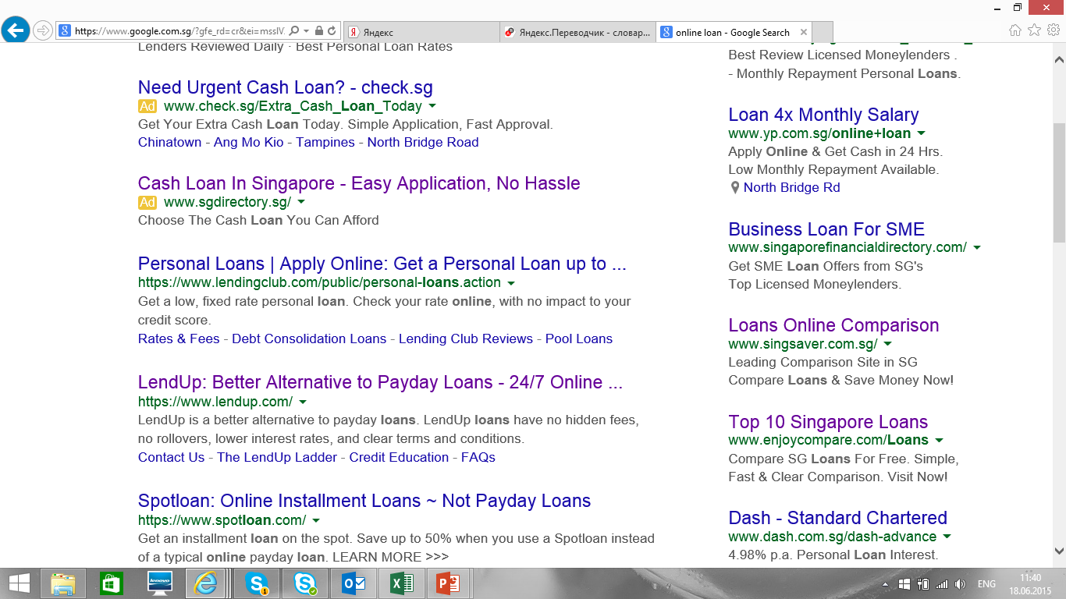
Ways to play in a legal territory
Current practices to get around advertising restrictions: advertise through online directories or comparison sites.
What is directory?
Web classifieds resource with ML banners that generates leads
There are dozens in the market place
Fully legally promoted in any media
Dominates in organic search
Exclusive in paid search
Exclusive deals are possible (manageable priority traffic)
Why is it legal?
it is not ML
It is not affiliated with ML
Has competitive banners
Has other then ML sections or content
An example of a site that calls itself "finance business directory". In fact this is hidden advertising for money lenders
Another way of hidden advertising of money lenders (paid search)

Slide 31
Our marcom strategy
Marcom approaches
LEGAL MEDIA: We shall use media that are allowed or available: Our website Our POS Organic search (SEO) Online Directories Comparison websites
“OWN MEDIA” We shall create own directories and comparison sites and market through them. (in financial model acquisition cost is equal to existing acquisition cost of the channel -25% ownership mark-up)
ALTERNATIVE CREATIVE SOLUTIONS We shall develop alternative ideas that gets us into legal territory. But very cautiously (further investigation is required and legal opinion is a must). e.g.: Mobile applications Discount card or other legal “shield” product Offline direct marketing Alternative POS like application terminals Virus marketing Targeting audience from outside Singapore jurisdiction
In media:
Legal media
“Own” media
In messages:
Combination of product and promo messages (e.g. “limited offer”)
“Drug” dealer approach (e.g. “first loan free”
We shall build brand Doctor Cash

Slide 32
Marketing mix & sales funnel
# | Marketing tools | Sales volume % | Lead cost $ | Approval rate % | Disbursement rate % | Client cost $
1 | Online directories | 70% | $125 | 80% | 90% | $174
2 | Search Engine Optimization | 15% | $70 | 80% | 90% | $97
3 | Comparison websites | 15% | $50 | 80% | 90% | $69
 | Total |  |  |  |  | $147
Volumes are confirmed as per financial model. Preliminary commitments on volumes and prices have been negotiated with leading online directories*
Meetings with director of directory «Notionage» (5 directories). Meeting with founder compare website «Onelyst». Meeting with founder AP Credit .

Slide 33


Our Brand
READY TO GO
Naming and graphic approach Examples: Doctor Dong Doctor Peso Doctor Dollar ---------------------------------------- Doctor Cash
Web domain names registered in all markets according to the following approach: doctorcurrency.xx (e.g. doctordollar.sg) drcurrency.xx (e.g drdollar.sg) doctorcash.xx (e.g doctorcash.sg) drcash.xx (e.g. drcash.sg)

Slide 34
Business process evolution & key competitive advantages
Within 2 months after the launch
Within 3 months after the launch
Within 6 months after the launch
Within 12 months after the launch
LGC (used for advertising)
Remote repeat sales
Agent sales
Pure online
Evolutionary step | Using separate LGC fee as additional source of income | Allowing customer to obtain repeat loans without branch visit or new credit contract signing | Remote contract signing during the meeting with courier at customer's home or work | Fully remote loan applying&obtaining process
Customer acquisition | Online | Online | Online | Online
Customer’s verification | Face-to-face at the office | Face-to-face at the office (for the first loan only) | Face-to-face during Agent’s visit (for the first loan only) | Online
Contract signing | Face-to Face in ML office | Offline at the office (for the first loan only) | Offline during Agent’s visit (for the first loan only) | Online (electronic signing)
Comments | Not yet implemented in the market | Not yet implemented in the market | Not yet implemented in the market | Not yet implemented in the market
We will start with traditional Online-to-Offline (O2O) model. Every subsequent step will be cleared with local legal advisors and Regulator first

Slide 35
5. Decision making & Collection

Slide 36
Typical risks
Main risks for our product we expect from clients with low income, and estimate it as 5% from disbursements (our competitors have risks from 4 to 6 % from disbursements for small loans)
Type of risk | Risk | Drivers to the risk/ comments | Tools for the risk reducing | Collection procedure comments
Fraud | - | Very strong laws – main driver of the absence of fraud Typical risk for black moneylenders only | - | -
Defaults for loans less than 5000 $ | No money | Typical risk for workers from other countries and with monthly income less than 2000$ | SingPass off-line Checking Checking by cheap on-line Credit bureau and blacklist | 1) SMS, Calls, e-mails 2) Most of debtors pay but with long delays
Defaults for loans more than 5000 $ | High debt-to-income, lots of loans, Pyramids | Mainly relevant for the banks | Checking by Credit bureau SingPass off-line Checking | SMS, Calls, e-mails If not paid - Bankruptcy procedures

Slide 37
SingPass opportunities
Singapore Personal Access (or SingPass), launched in March 2003, is a gateway to hundreds of e-services offered by more than 60 government agencies, enabling users to only have and remember one password when connecting and transacting with the Government.
Some ML companies require customers to demonstrate their income for last 12 months in personal account SingPass. To do this, companies provide customers with a computer connected to the Internet.
# | Information | Short description
1 | What information can be checked? | Proof of income, Any property client owns
2 | Who can have Eligibility for SingPass? | Singapore Citizen and Permanent Resident Employment Pass and Personalized Employment Pass holders EntrePass holders, S-Pass holders Dependent Pass holders (of EP, PEP, EntrePass and S-Pass holders) Long-Term Visit Pass-Plus (LTVP+) holders (Issued by ICA) Selected Work Permit holders
3 | Who have access to SingPass base? | Only users can enter individually
4 | How we can check customer’s data | Client can show us information by safe computer.
5 | Online options for check | No
SingPass allows us to verify the validity of income and property information provided by the customer. But it can’t be automated

Slide 38
Credit bureaus
A variety of options for performing customer checks exists in the market, however, some of them are pretty expensive:
Credit bureau** | Report cost | Online reporting | Hit Rate | WEB
Credit Bureau of Singapore (CBS) | The price is $6.50 per report | Temporarily blocked | 100%* | http://www.creditbureau.com.sg
SML 999 | $0.03 per basic search $1.50 per detailed search | Yes | 75% | https://www.sml999.com
DnB Consumer report | $3-4 per report, depending on package | Yes | 100%* | http://www.dnb.com.sg
DP Credit Bureau | Price is unknown for now (02.07.2015) | Yes | 65% | https://www.dpcreditbureau.sg
MLAS (black lists) | $380 per year for unlimited search | Yes | Not available | https://moneylenders.sg
*- not only credit history, any data.
**- source of information – Daniel (founder AP Credit), manager DnB, manager CBS and manager DP Credit Bureau (meetings)

Slide 39
Strategy of the risk procedures developing
Within 2 months after the launch
Within 3 months after the launch
Within 6 months after the launch
Within 12 months after the launch
LGC (using for advertising)
Remote repeat sales
Agent sales
Pure online
Decision making | Work off-line with SingPass Use automotive checking procedures Use automotive checking by cheap on-line Credit bureau and blacklist | Work off-line with SingPass Use automotive checking procedures Use automotive checking by cheap on-line Credit bureau and blacklist | Work with SingPass by tablet of couriers or mobiles of clients Use automotive checking procedures Use automotive checking by cheap on-line Credit bureau and blacklist Use mobile and work phone verifications Implement the own scorecards | Try to work with SingPass on-line Use automotive checking procedures Use automotive checking by cheap on-line Credit bureau and blacklist Use mobile and work phone verifications Correct the own scorecards
Collection procedure | SMS Calls E-mails | SMS Calls E-mails | SMS Calls E-mails Sales | SMS Calls E-mails Sales

Slide 40
Decision making procedure
# | Check | Off-line | On-line with courier | Full on-line
1 | Visual stop factors | In an offline office | During the meeting with courier
2 | Auto Stop-factors | Age, employment, resident, income
3 | Local credit bureau information | SML999, DP Credit Bureau
4 | Black lists and databases | Criminal records, bank black lists, MLAS directory search
5 | Credit rules | Different logic rules, depending on credit history, max. loan amount calculation, etc.
6 | Scoring | Social-demographic
7 | Documents and data checking | checking incomes and other data by SingPass |  | Try to use SingPass online
8 | Work phone verification | ??? | Checking information provided by potential customer, check for obvious signs of fraud
9 | Phone verification | ??? | Checking information provided by potential customer, check for obvious signs of fraud
The list of required documents:
NRIC (national passport)
Income proof (Latest Payslip or Employment/Appointment Letter or CPF Contribution Statement or Latest Bank Statement)
Average decisioning time is expected to be within 15-20 minutes, including phone verifications (for good applicants – short phone verification, for not good – long phone verification)

Slide 41
Collections procedure
Due the fact that the ultimate beneficiary is responsible for collectors’ actions, we plan to make most of the collection operations in-house:
Pre-, Early- and Soft-collection are planned to be executed in-house by company’s employees – we plan to use own Call center for that purpose
Hard collection (clients visits) will not be done due to tough regulator’s requirements for collection process
Selective Legal collections are planned to be outsourced (optional)
# | Stage | Short description | Inhouse/Outsourced
1 | Early collections | Email and call for reminding the customers to make the payment, at early delinquency stage option of renewal for a some fee | In-house
2 | Soft collections | Email/mail/call for reminding the customers to make the payment, at medium stage of delinquency | In-house
3 | Selective Legal collections | Official request to the court for the debt collection | Outsourced/optional
4 | Sales | Try to sale of the debt after 180-360 days of delays | Sales/optional

Slide 42
6. IT

Slide 43
Approach to building IT for SG
We will use “BPM Online” solution from Terrasoft, developed for VN MFI project, as a basis for building business processes in SG
However, these business processes will have to be slightly modified to account for SG-specific business processes (branch-based, online-to-branch, full online with electronic contract signing)
Telephony & Call-centre – we are planning to use CN-based outsourcing call center with workplace outsourcing and Terrasoft-integrated solution Webitel as a telephony system
As in every market, we will have to integrate with the following local partners:
Bank – to setup loan disbursal and payment collection*
Credit bureaus – to send requests and receive answers online
Blacklist services – to send requests and receive answers online
Local SMS operator – to send verification SMSs
GL accounting and reporting software
Such an approach allows us to minimize IT development budget, keeping it under $200K
* We are in negotiation process with a few banks

Slide 44
Initial workflow
We start from the workflow, currently used in the market by all players (requires customer visit to the branch and allows to receive money within couple hours from the moment of application)

Slide 45
Transitional workflow
Transitional business process will allow customers to receive money within 0,5-2 hours after applying online, without necessity for a branch visit (depending on customer’s availability for courier’s visit)

Slide 46
Target (fully online) workflow
Target business process will allow customers to receive money within 15-30 minutes after submitting online application with money delivered directly into his bank account

Slide 47
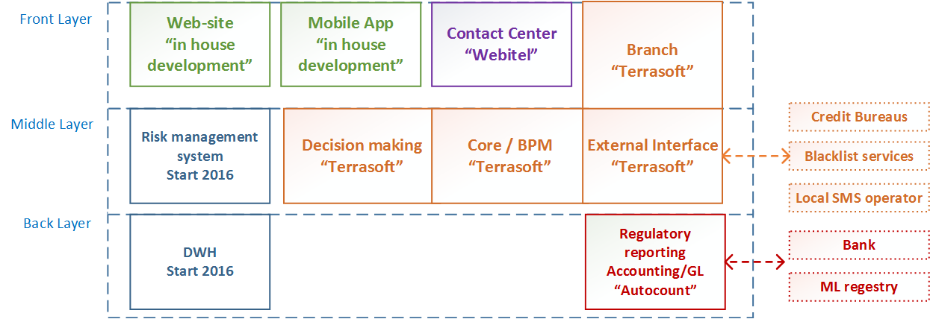
IT architecture

Slide 48
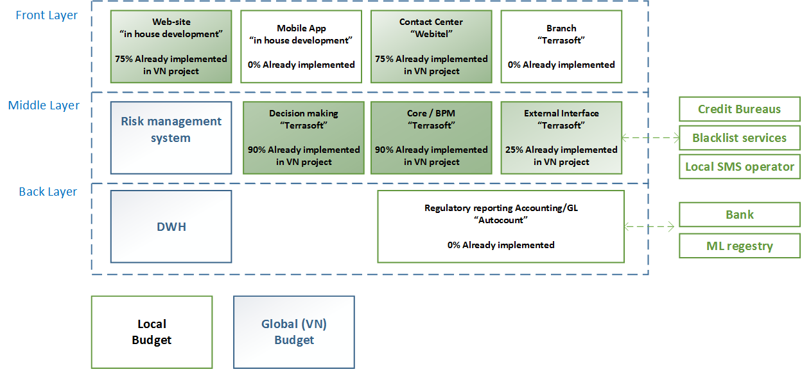
IT architecture- incremental view

Slide 49
IT budget components
# | IT component | License price | Initial Implementation/ development price | Support price (per year) | Further development budget (per year) | Comments
1 | CRM: "BPMOnline" by Terrasoft | 0 | $75K* | $4K | $14K | Covers integration, language localization, business process and product modification
2 | Contact center: "Webitel" solution | $325 per user | $7K | $1K | 0 | Specialized CC solution with "out of the box" integration with BPMOnline
3 | Local GL solution: “Autocount” | $40K | $40K | $8K | $4K | Covers reporting
4 | Local web-site | 0 | $1K | 0 | $1K | Language localization, application form change
5 | Directories and comparison sites | 0 | $20K | $1K | $5K | Creating at least 3 sites to promote the ML services
 | Total | $45K** | $123K | $14K | $19K
* Final quotation from Terrasoft not received
** For 14 users Contact Center

Slide 50
IT budget inputs – not varying with volumes
# | Expenses item | Price per month, USD | Comments
1 | Outsourced data centers | $6K | Singapore Data Center
2 | Office internet connection | $4K | Up to 50 users, including Contact Center
3 | Office support | $1K | Outsourcing IT support for 30 users
 | Total | $11K

Slide 51
IT budget inputs – varying with volumes
# | Expenses item | Price per unit, USD | Comments
1 | Call center equipment | $650 | Package includes desktop, monitor, keyboard, mouse + phone + headset
2 | Contact Center (“Webitel”) licenses | $325 (€250) | One license per each workplace (per two operators)
3 | Equipment for employees | $650 | Includes PC/monoblock, monitor, keyboard, mouse.
4 | Equipment for management | $2000 | Includes notebook, monitor, keyboard, mouse. Used for top management
5 | Printers/MFD | $600 | One per 15 employees

Slide 52
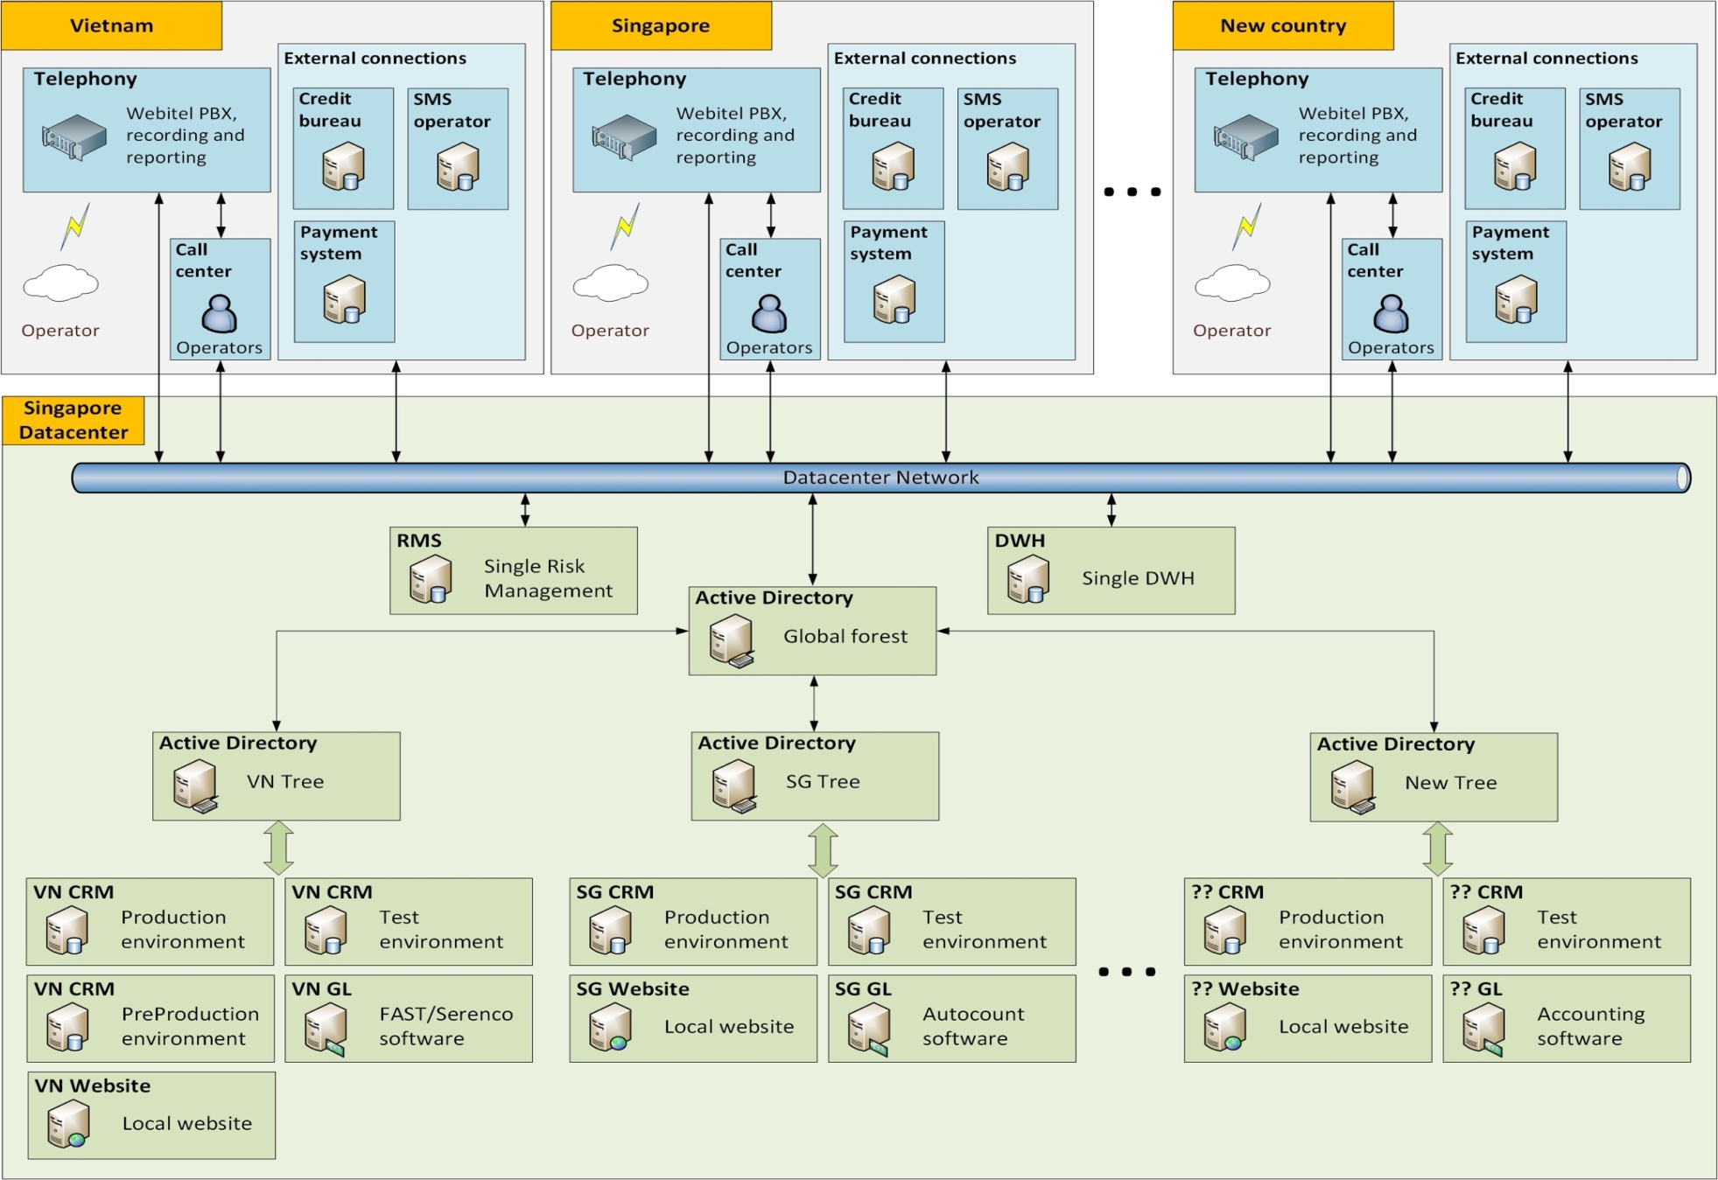
We will use standard IT architecture geo layout

Slide 53
7. HR & Admin information

Slide 54
HR Structure. Existing model (first 6 months)
First 6 months after the launch
Typical Singapore moneylenders have little staff. Taking into account that we launch operations according to the same business model, our starting staff schedule will be close to that of a typical current moneylender:
Position | Total Count | Salary (paid to employee), USD | CPF * contribution | Total salary, USD | Division
CEO (Director) | 1 | 12 000 | 17% | 14 040 | HQ
Country Manager | 1 | 5 500 | 17% | 6 435 | HQ
Office administrator | 1 | 3 000 | 17% | 3 510 | Operations
Loan executive | 3 | 2 500 | 17% | 8 775 | Sales
Telecollectors (1-30 DPD) | 1 | 3 000 | 17% | 3 510 | Collections
Telecollectors (31-90 DPD) | 1 | 3 000 | 17% | 3 510 | Collections
Skip Tracing (91 DPD) | 1 | 3 000 | 17% | 3 510 | Collections
Telecollectors (91+ DPD) | 1 | 3 000 | 17% | 3 510 | Collections
Legal advisor | 1 | 3 500 | 17% | 4 095 | Legal
Chief accountant | 1 | 7 200 | 17% | 8 424 | Finance
MIS | 1 | 4 000 | 17% | 4 680 | Finance
Digital marketing specialist | 1 | 4 000 | 17% | 4 680 | Marketing
IT support | 1 | 4 500 | 17% | 5 265 | IT
CC Operators (support) | 2 | 3 000 | 17% | 7 020 | Operations
Total | 17 |  |  | 80 964
* CPF – Central Provident Fund, the Pension Fund of Singapore

Slide 55
HR Structure. Transition model
After 6 months we go over to the transitionary business model. The number of office staff (IT, Marketing, Risks) increases significantly. Couriers enter the staff schedule. Total headcount increases to 46 people.
Position | Total Count | Salary (paid to employee), USD | CPF * contribution | Total salary, USD | Division
CEO (Director) | 1 | 12 000 | 17% | 14 040 | HQ
Country Manager | 1 | 5 500 | 17% | 6 435 | HQ
Personal assistant | 1 | 2 500 | 17% | 2 925 | Operations
Office administrator | 2 | 3 000 | 17% | 7 020 | Operations
Head of sales | 1 | 7 200 | 17% | 8 424 | Sales
Loan executive | 3 | 2 500 | 17% | 8 775 | Sales
Couriers | 8 | 2 500 | 17% | 23 400 | Sales
Head of risk | 1 | 7 200 | 17% | 8 424 | Risks
Verificators | 5 | 3 000 | 17% | 17 550 | Risks
Telecollectors (1-30 DPD) | 1 | 3 000 | 17% | 3 510 | Collections
Telecollectors (31-90 DPD) | 2 | 3 000 | 17% | 7 020 | Collections
Skip Tracing (91 DPD) | 1 | 3 000 | 17% | 3 510 | Collections
Telecollectors (91+ DPD) | 2 | 3 000 | 17% | 7 020 | Collections
Head of legal | 1 | 7 200 | 17% | 8 424 | Legal
Legal advisor | 1 | 3 500 | 17% | 4 095 | Legal
Chief accountant | 1 | 7 200 | 17% | 8 424 | Finance
Accountant | 1 | 5 000 | 17% | 5 850 | Finance
MIS | 1 | 4 000 | 17% | 4 680 | Finance
Head of marketing | 1 | 7 200 | 17% | 8 424 | Marketing
Digital marketing specialist | 3 | 4 000 | 17% | 14 040 | Marketing
Head of IT | 1 | 7 200 | 17% | 8 424 | IT
IT support | 2 | 4 500 | 17% | 10 530 | IT
HR Director | 1 | 7 200 | 17% | 8 424 | HR
Trainers | 1 | 4 500 | 17% | 5 265 | HR
CC Operators (support) | 3 | 3 000 | 17% | 10 530 | Operations
Total | 46 |  |  | 215 163
* CPF – Central Provident Fund, the Pension Fund of Singapore

Slide 56
HR Structure. «Ideal» model
The “ideal” model starts 12 months after beginning of operations. It no longer requires couriers, but there will be increase in the number of verificators, call center employees and other staff due to overall business growth.
Position | Total Count | Salary (paid to employee), USD | CPF * contribution | Total salary, USD | Division
CEO (Director) | 1 | 12 000 | 17% | 14 040 | HQ
Country Manager | 1 | 5 500 | 17% | 6 435 | HQ
Personal assistant | 1 | 2 500 | 17% | 2 925 | Operations
Office administrator | 2 | 3 000 | 17% | 7 020 | Operations
Head of sales | 1 | 7 200 | 17% | 8 424 | Sales
Loan executive | 4 | 2 500 | 17% | 11 700 | Sales
Head of risk | 1 | 7 200 | 17% | 8 424 | Risks
Verificators | 8 | 3 000 | 17% | 28 080 | Risks
Telecollectors (1-30 DPD) | 2 | 3 000 | 17% | 7 020 | Collections
Telecollectors (31-90 DPD) | 4 | 3 000 | 17% | 14 040 | Collections
Skip Tracing (91 DPD) | 2 | 3 000 | 17% | 7 020 | Collections
Telecollectors (91+ DPD) | 5 | 3 000 | 17% | 17 550 | Collections
Head of legal | 1 | 7 200 | 17% | 8 424 | Legal
Legal advisor | 1 | 3 500 | 17% | 4 095 | Legal
Chief accountant | 1 | 7 200 | 17% | 8 424 | Finance
Accountant | 1 | 5 000 | 17% | 5 850 | Finance
MIS | 1 | 4 000 | 17% | 4 680 | Finance
Head of marketing | 1 | 7 200 | 17% | 8 424 | Marketing
Digital marketing specialist | 3 | 4 000 | 17% | 14 040 | Marketing
Head of IT | 1 | 7 200 | 17% | 8 424 | IT
IT support | 2 | 4 500 | 17% | 10 530 | IT
HR Director | 1 | 7 200 | 17% | 8 424 | HR
Trainers | 1 | 4 500 | 17% | 5 265 | HR
CC Operators (support) | 5 | 3 000 | 17% | 17 550 | Operations
Total | 51 |  |  | 236 808
* CPF – Central Provident Fund, the Pension Fund of Singapore

Slide 57
8. Finance

Slide 58
Main assumptions and sensitivity analysis
Main Loan parameters
Loan type | Average loan size, USD | Average term | Early repayments | 1st prolongation | 2nd prolongation | Conversion to next tier | Roll-rate 0->1 | Roll-rate 1->2 | Roll rate 2->3+ | Total losses (with prolongations)
Tier 1 loans | 1 250 | 30 days | 20% | 25% | 10% | 50% | 19% | 60% | 70% | 5,5%
Tier 2 loans | 1 375 | 30 days | 10% | 20% | 5% | 50% | 19% | 60% | 70% | 5,5%
Tier 3 loans | 1 720 | 30 days | 10% | 20% | 5% | 50% | 19% | 60% | 70% | 5,5%
Income and expenses parameters
Loan type | Normal interest rate, per day | Late penalty interest rate, per day | Disbursement fee received | Prolongation fee received | Marketing acquisition cost, USD
PDL Loans | 0,13% | 0,26% | 14,8% | 14,8% | 147
Sensitivity analysis
Sensitivity to number of clients | 70% | 80% | 90% | 100% | 110% | 120% | 130% |  | Sensitivity to PDL size | 70% | 80% | 90% | 100% | 110% | 120% | 130%
5 years Profit after taxes | 9 762 | 12 757 | 15 666 | 18 607 | 21 555 | 24 347 | 27 219 |  | 5 years Profit after taxes | 3 222 | 8 435 | 13 553 | 18 607 | 23 642 | 28 669 | 33 690
5 years average yearly ROE | 31% | 39% | 47% | 53% | 58% | 63% | 67% |  | 5 years average yearly ROE | 8% | 23% | 38% | 53% | 67% | 80% | 93%
Sensitivity to prolongation rates | 70% | 80% | 90% | 100% | 110% | 120% | 130% |  | Sensitivity to conversion rates | 70% | 80% | 90% | 100% | 110% | 120% | 130%
5 years Profit after taxes | 14 957 | 16 177 | 17 386 | 18 607 | 19 815 | 21 002 | 22 200 |  | 5 years Profit after taxes | 10 071 | 12 428 | 15 108 | 18 607 | 22 842 | 28 016 | 34 725
5 years average yearly ROE | 42% | 46% | 49% | 53% | 56% | 59% | 62% |  | 5 years average yearly ROE | 32% | 38% | 45% | 53% | 61% | 71% | 82%
Sensitivity to NPL level | 70% | 80% | 90% | 100% | 110% | 120% | 130% |  | Sensitivity to marketing costs | 70% | 80% | 90% | 100% | 110% | 120% | 130%
5 years Profit after taxes | 21 299 | 20 419 | 19 468 | 18 607 | 17 743 | 16 813 | 15 838 |  | 5 years Profit after taxes | 24 762 | 22 715 | 20 664 | 18 607 | 16 542 | 14 453 | 12 318
5 years average yearly ROE | 67% | 62% | 57% | 53% | 48% | 44% | 40% |  | 5 years average yearly ROE | 79% | 70% | 61% | 53% | 45% | 37% | 30%

Slide 59
Investment summary
Investment summary |  |  |  | Timeline
thsd USD | Year 1 | Year 2 | Year 3 | Year 4 | Year 5* | Total
investments | 3 131 | 5 980 | 115 | 0 | 0 | 9 226
Total investments | 3 131 | 5 980 | 115 | 0 | 0 | 9 226
Number of loans issued (thsd) | 1 | 27 | 51 | 62 | 67 | 208
Amount disbursed | 1 684 | 37 647 | 70 956 | 86 158 | 93 142 | 289 586
Net portfolio (EoY) | 759 | 6 363 | 9 097 | 10 702 | 11 019 | 11 019
Revenue | 348 | 10 255 | 21 070 | 26 065 | 28 512 | 86 250
G&A ** | -803 | -3 250 | -3 359 | -3 281 | -3 355 | -14 049
One-off expenses *** | -1 113 | 0 | 0 | 0 | 0 | -1 113
Net profit after taxes | -1 141 | 205 | 4 617 | 6 876 | 8 050 | 18 607
ROE (yearly) | -65% | 3% | 48% | 72% | 84% | 53%
ROAA (yearly) | -97% | 4% | 47% | 57% | 61% | 39%
* - normalized year with no new clients growth
** - see slide 63 for details
*** - see slide 64 for details
Break-even period – 18 months
Payback period – 29 months
Maximum investments from – 9,2 mln USD

Slide 60
Balance sheet
Balance Sheet (EOY) | Timeline
thsd USD | Year 1 | Year 2 | Year 3 | Year 4 | Year 5
Assets | 2 357 | 8 543 | 11 250 | 12 969 | 13 210
Liquid assets | 621 | 1 280 | 1 474 | 1 682 | 1 742
Loans to individuals (net of provisions) | 994 | 6 593 | 9 180 | 10 764 | 11 019
PDL | 1 078 | 8 735 | 15 263 | 21 643 | 27 093
Risk provisions - PDL | -84 | -2 141 | -6 083 | -10 878 | -16 074
Noncurrent assets | 743 | 669 | 596 | 522 | 449
Liabilities | 1 901 | 6 954 | 7 069 | 7 069 | 7 069
Loans | 1 901 | 6 954 | 7 069 | 7 069 | 7 069
External debt financing (COF = 15%) | 0 | 0 | 0 | 0 | 0
Shareholders' equity | 456 | 1 589 | 4 181 | 5 900 | 6 142
Contributed equity | 1 597 | 2 525 | 2 525 | 2 525 | 2 525
Retained earnings | -1 141 | -936 | 1 656 | 3 375 | 3 617

Slide 61
P&L Statement
P&L |  |  |  | Timeline
thsd USD | Year 1 | Year 2 | Year 3 | Year 4 | Year 5 | Total
Revenue | 348 | 10 255 | 21 070 | 26 065 | 28 512 | 86 250
Risk provisions | -84 | -2 057 | -3 941 | -4 796 | -5 196 | -16 074
% of revenue | -24% | -20% | -19% | -18% | -18% | -19%
Acquisition costs - marketing | -192 | -3 826 | -6 738 | -8 076 | -8 616 | -27 448
% of revenue | -55% | -37% | -32% | -31% | -30% | -32%
Acquisition costs - other | -9 | -459 | -604 | -726 | -767 | -2 564
% of revenue | -3% | -4% | -3% | -3% | -3% | -3%
Support costs | -29 | -355 | -659 | -812 | -843 | -2 698
% of revenue | -8% | -3% | -3% | -3% | -3% | -3%
VAT | 0 | 0 | -54 | -114 | -148 | -315
Operating profit (before fixed costs) | 33 | 3 557 | 9 075 | 11 542 | 12 942 | 37 150
% of revenue | 10% | 35% | 43% | 44% | 45% | 43%
G&A | -803 | -3 250 | -3 359 | -3 281 | -3 355 | -14 049
% of revenue | -231% | -32% | -16% | -13% | -12% | -16%
One-off expenses | -346 | 0 | 0 | 0 | 0 | -346
Depreciation and amortization | -24 | -73 | -73 | -73 | -73 | -318
Profit before Taxes | -1 140 | 234 | 5 642 | 8 188 | 9 514 | 22 437
% of revenue | -328% | 2% | 27% | 31% | 33% | 26%
Income tax | -1 | -29 | -1 025 | -1 312 | -1 464 | -3 830
Profit after Taxes | -1 141 | 205 | 4 617 | 6 876 | 8 050 | 18 607
% of revenue | -328% | 2% | 22% | 26% | 28% | 22%

Slide 62
Cash flow Statement
Cash flow statement |  |  | Timeline
thsd USD | Year 1 | Year 2 | Year 3 | Year 4 | Year 5 | Total
Cash flow from operations | -687 | 2 336 | 8 632 | 11 745 | 13 319 | 35 345
Income | 348 | 10 255 | 21 070 | 26 065 | 28 512 | 86 250
Acquisition costs | -201 | -4 285 | -7 342 | -8 802 | -9 383 | -30 012
Support costs | -29 | -355 | -659 | -812 | -843 | -2 698
G&A | -803 | -3 250 | -3 359 | -3 281 | -3 355 | -14 049
VAT | 0 | 0 | -54 | -114 | -148 | -315
CIT | -1 | -29 | -1 025 | -1 312 | -1 464 | -3 830
Cash flow from investing | -2 191 | -7 657 | -6 528 | -6 380 | -5 451 | -28 206
PDL Loans disbursed | -2 027 | -48 684 | -92 945 | -113 040 | -122 420 | -379 116
PDL Loans repaid | 949 | 41 028 | 86 417 | 106 660 | 116 969 | 352 023
One-off expenses | -1 113 | 0 | 0 | 0 | 0 | -1 113
Cash flow from financing | 3 131 | 5 980 | -1 910 | -5 157 | -7 808 | -5 764
Contributed equity | 1 230 | 927 | 0 | 0 | 0 | 2 158
Loans | 1 901 | 5 053 | 115 | 0 | 0 | 7 069
External debt financing | 0 | 0 | 0 | 0 | 0 | 0
Dividends paid | 0 | 0 | -2 025 | -5 157 | -7 808 | -14 990
Cash flow total | 254 | 659 | 194 | 208 | 60 | 1 375

Slide 63
G&A expenses budget
G&A, thsd USD |  |  | Timeline
 | 2015 | 2016 | 2017 | 2018 | 2019 | Total
Expenses category
Salary | 370 | 1 841 | 2 151 | 2 206 | 2 280 | 8 848
Rent | 65 | 422 | 422 | 422 | 422 | 1 755
Marketing & PR | 125 | 270 | 270 | 270 | 270 | 1 205
IT | 28 | 206 | 126 | 126 | 126 | 612
Legal | 75 | 60 | 60 | 60 | 60 | 315
Travel | 25 | 60 | 60 | 60 | 60 | 265
Contingency | 115 | 391 | 270 | 137 | 137 | 1 049
Total | 803 | 3 250 | 3 359 | 3 281 | 3 355 | 14 049

Slide 64
One-off costs budget
One-off expenses, thsd USD
 | 2015 |  | Type
Expenses category
Licensing | 530
ML License acquisition | 400 |  | Capitalized
ML License acquisition (transaction expenses) | 100 |  | Written-off to expenses
LGC registration | 15 |  | Written-off to expenses
LGC parental company registration | 15 |  | Written-off to expenses
Offices | 307 |  | Capitalized
IT | 181
Contact center licenses | 5 |  | Capitalized
Local General Ledger implementation | 40 |  | Written-off to expenses
Local General Ledger license | 40 |  | Capitalized
Terrasoft adaptation & translation | 75 |  | Capitalized
Directories and comparison sites development | 20 |  | Capitalized
ML Web Site development | 1 |  | Capitalized
Recruiting | 90 |  | Written-off to expenses
Brand registration | 5 |  | Capitalized
Total | 1 113

Slide 65
9. Project risks and mitigation

Slide 66
Main identified risks and their mitigation 1/2
# | Risk type | Risk | Mitigation tool
1 | Target license | Changing license seller position (will not be ready to sell / will increase price) | Identifying alternative sellers
2 | Licensing | Regulator will not approve 100% company transfer | Buying out portion of the company, with the option to buy out the rest
 |  | Regulator will not approve license extension in a year | Establishing working relationship with Regulator
3 | Target business model | Negative legal opinion on Target business model | Start working with existing business-model Working with Legal to develop close-to-ideal business model
 |  | Failure to achieve target volumes due to advertising channels limits | Launch of directories and comparison site for lead generation.
4 | Operational | Invalid and/or incorrect personal data in online application (on web site or in CRM) | Built-in auto online checks Obligatory mobile number SMS-verification procedure
 |  | Signed paper application and/or customer’s documents copies loss | Saving photos of the documents in CRM right after signing Control of the person, responsible for documents’ originals delivery in CRM Personal responsibility in case documents’ loss (manager will have to provide new documents/copies)

Slide 67
Main identified risks and their mitigation 2/2
# | Risk type | Risk | Mitigation tool
5 | Collections | Customers unavailability in case of committing delinquency | Mandatory request of providing contact person’s mobile number in application Contract signing during the meeting with DSA only at customer’s home or work
 |  | Denying loan receipt in case of not repaying | Sending the copy of signed contract to the customer via email and personal online’/mobile application account (on 2 phase)

Slide 68
10. Project plan

Slide 69
Project plan
Activity | Planning end date | Comments
Hiring CEO | July 2015 | HR agencies already started search.
Buying license | September 2015 | Preparing for consultation with the regulator
Renting office | August 2015 | We start this process after getting approval from Regulator
Creating team | August-September 2015 | We have 3 HR agencies for this process
IT settings, product settings | September-October 2015 | We already have part of IT solutions
Start operations | October 2015 | Operations can be launched in October.
LGC setup | October 2015 | We will work with a market LGC company on a commercial basis or will establish our own
Approving transitionary model in Regulator | January-Mart 2016 | We will build a business case with a local law firm for a new business model that will allow us to work with clients remotely and will do our best to get regulator approval for it
Approving ideal model in Regulator | August-September 2016
The most difficult and time-consuming process is the acquisition of license

Slide 70
11. Appendices

Slide 71
Appendix 1. Countries comparison table
Metric | VN | SG | PH
Population (MM) | 92,5 | 5,5 | 107,7
GDP per capita (nominal, $’000) | 2,1 | 55 | 2,5
GDP per capita (PPP, $‘000) | 5,6 | 79 | 7,0
Consumer loans (incl. mortgages) / GDP | 5,6% | 76% | 6,6%
Total unsecured loans ($Bn) | 4,9 | 42
Unsecured loans per capita ($) | 53 | 7 685

Slide 72
Appendix 2. Recommendations of the Advisory Committee on Moneylending
S/No | Recommendation
1 | Moneylenders should only be allowed to charge borrowers the following: Upfront administrative fee of not more than 10 per cent of loan principal; Interest of not more than four per cent per month; Late interest of not more than four per cent per month; and (iv) Late fee of not more than $60 per month. Total borrowing costs capped at 100% of loan principal. Caps to be reviewed when better data is available from the Moneylenders Credit Bureau (MLCB).
2 | Borrowers earning less than $20,000 a year should be allowed to borrow only up an aggregate of $3,000. For other borrowers, they are allowed to borrow up to six times their monthly salary in aggregate. These caps should be independent of the Monetary Authority of Singapore’s caps on unsecured borrowings from financial institutions.
3 | Moratorium on grant of new licences should be lifted.
4 | Research should be conducted into the classes and characteristics of borrowers who should not be borrowing from moneylenders. Alternative forms of support, such as counselling, debt restructuring, etc. can then be tailored to these groups of borrowers.
5 | A formalised debt restructuring regime with collective representation of the moneylenders should be introduced.

Slide 73
Appendix 2. Recommendations of the Advisory Committee on Moneylending
S/No | Recommendation
6 | The Registry of Moneylenders should monitor the situation of moneylenders operating in the heartlands and ensure that the situation is not aggravated.
7 | Credit information on borrowers should be aggregated so as to allow better decision-making by moneylenders.
8 | Borrowers who are excluded from the local casinos should be flagged out to moneylenders through the MLCB before the loan is granted.
9 | Moneylenders should adhere to a set of standardised loan terms and practices. Repayments should be aligned to a borrower’s wage cycle, and should be set on a monthly basis by default. Interest should be calculated on a reducing balance basis.
10 | Moneylenders should be required to incorporate and should have a paid-up capital of at least $100,000. They should be required to submit annual audited accounts to the Registry.
11 | Moneylenders could be allowed to advertise in the newspapers using strict templates designed by the Registry so as to prevent misleading advertisements. The number and frequency of such advertisements can also be controlled.
12 | Guidelines on acceptable debt collection behaviour should be introduced.
13 | Effects of late repayment should be explained to borrowers in dollar terms.
14 | Business loans, defined as loans to businesses which have been registered for at least two years, should not be subject to the loan quantum and borrowing costs caps.
15 | The Registry should collect a better set of data on both borrowers and moneylenders. The Committee has recommended a list of data items that may be useful.

Slide 74
Appendix 3. Legal advertising
Since direct advertising of ML services is prohibited in Singapore, we plan to use several indirect channels:
Specialized “Consumer Finance Directory” websites
http://sgmoney.sg
http://directory.stclassifieds.sg
http://www.singaporefinancialdirectory.com
These sites appear as a contextual ads in Google search results when searching for terms like “Personal/fast/easy loan”. Formally being just a directory of companies, they are in fact advertising sites, because they only provide information on certain moneylender companies.
Loan comparison or credit brokerage websites
https://www.onelyst.com
These sites offer to fill in an online application form, then show offers from several financial institutions, listing the terms of the product offered (interest rate, time period, amount etc.) Most of those resources only compare bank loans, however, at least one site specializes on moneylenders.
“Yellow pages”
http://businesspages.com.sg
http://bizlistings.sg
http://www.yellowpages.com.sg
These sites do not actually advertise anything, they are just the lists of a certain industry companies. However, they are very popular and easily promoted in Internet.

Slide 75
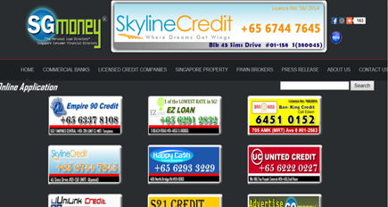






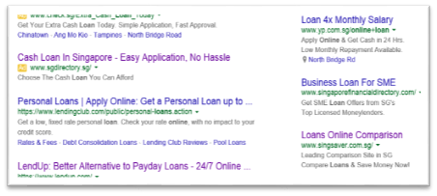
Appendix 4. Marketing messages
Example of website which claims to be a finance business directory.
Example: Banners in business directories
Example: Google compare websites

Slide 76
Appendix 5. Moneylenders’ Association of Singapore
The Association has set the following as its objectives:
To represent, develop and promote the money lending industry and to generally further the interests of its members.
To project money lending as an important and integral part of the business of financing individuals and businesses.
To keep members informed of matters relating to the trade and the finance industry generally and to facilitate their interaction so as to better promote their interest in the industry.
To maintain good relations with governmental authorities and to assist them through regular feedback.
To advocate ethical practice in the money lending industry.
Cost of membership is one time Entrance Fee of $500 and Annual Subscription Fees of $380
The Association provides the following services to the members:
An access to a black list of ML customers compiled from all MLAS members’ databases
Preferential access to DP SME Commercial Credit Bureau
Web site development at favorable conditions
Insurance protection for MLAS Members
Orientation & Training for Moneylenders
Preferential access to collection agencies

